Slide 1
Digitization- Need of the hour
India had an internet users base of about 475 million as of July 2019, about 40% of the population. This number has increased to 627 million by the end of 2019.
We could see a growth of 32% in a span of 5 months bringing 53% of population on internet.
With increased mobile networks outreach, cheapest plans in comparison to the world, growing awareness towards Smartphones and its capabilities we expect the numbers of internet users to grow exponentially in near future.
With Government’s Digital India plan and policies Digitization and online presence is the new normal.
Close to 329.1 million people are projected to buy goods and services online in India by 2020.

Slide 2
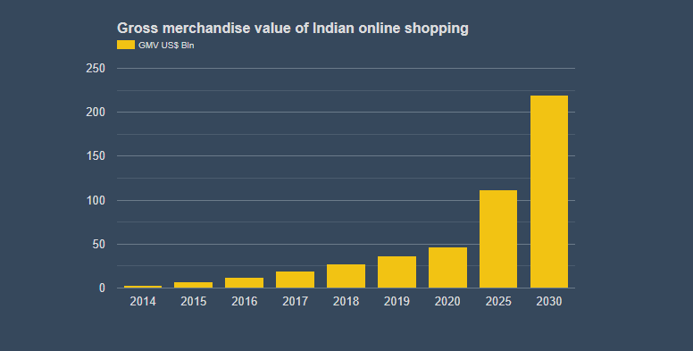
Digitization- Year on year growth Trend

Slide 3
Digitization- WHY IT IS IMPORTANT !!
DIGITAL POPULATION AS OF JANUARY 2020
687.6 Million
EXPECTED E-COMMERCE MARKET SIZE BY 2027
200 bn USD
ACTIVE E-COMMERCE PENETRATION
74%

Slide 4
Digitization IN MSME
Online shoppers in India are growing at compounded annual growth rate (CAGR) of 18%
Out of 51 million SMEs in India, less than 5-6% have an online presence
Research shows that the companies migrating to an online platform could potentially increase their revenues by 51%, improve operational efficiency and broaden their customer
Government schemes such as Start-up India, Digital India, E-Governance, etc. are also helping the MSME sector in India

Slide 5
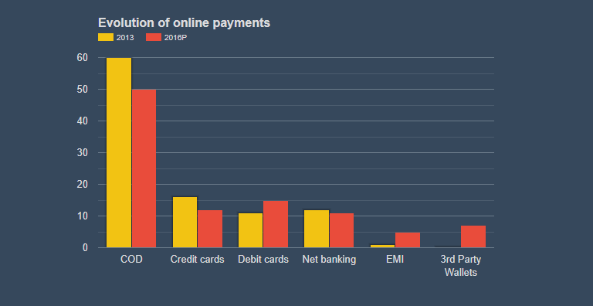
Digitization- WORRIED ABOUT YOUR PAYMENT?
With Introduction of e-wallets and other digital payment methods, cash, COD transactions are taking a dip every year. This helps our MSME vendors to get the amount instantly credited to their account.

Slide 6
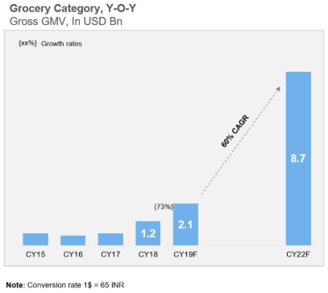
Digitization in ONLINE GROCERY MARKET
Online Grocery is expected to grow at 60% CAGR

Slide 7
Digitization in ONLINE GROCERY MARKET-FUTURE
Hyperlocal e-grocery- Market growing at triple digits
Daily Essentials category has grown rapidly within the online grocery market- accounting for ~40% of all transactions
Online grocery verticals have been able to shift one third of their user base to subscription programs
Super verticals are playing a key role in habituating consumers to online meat purchases

Slide 8
Digitization- Case study
Haldiram’s Foods International
Haldiram’s is a brand with a lot of legacy. When we ventured into the digital world, our biggest lookout was to not disrupt what we have already created. Our digital strategy focuses on augmenting the brand in every possible way. We now actively spend on digital initiatives such as our online store and our outreach on Google,Facebook, and Twitter.
Our initiatives have helped us build our brand presence among the younger generation. Our online sales are now 10% of a physical store, with a fraction of the cost. We are now looking forward to launching apps for Android and iOS in the coming months. With these initiatives, we are targeting 1,000 orders per day from the online store and apps this festive season.
—Neeraj Agrawal,Director,Haldiram’s Foods International

Slide 9
Bibliography
Google.com
Wikipedia.com
Dqindia.com
Statista.com
Redseer.com

